Slide 1
JFET characteristics

Slide 2
Two main characteristics
Transfer characteristics
Output characteristics

Slide 3
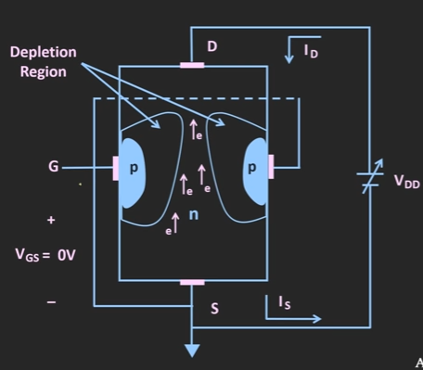



Output characteristics - comparison
CE transistor characteristics
JFET characteristics
$I_{D} versus V_{DS}$
For different $V_{GS}$ (controlling voltage)
For n channel JFET
${ V}_{GS}$<0
For n channel JFET
${ V}_{GS}>$0
$I_{C} versus V_{CE}$
For different
$$I_{B}$$
IB is acting as controlling current

Slide 4
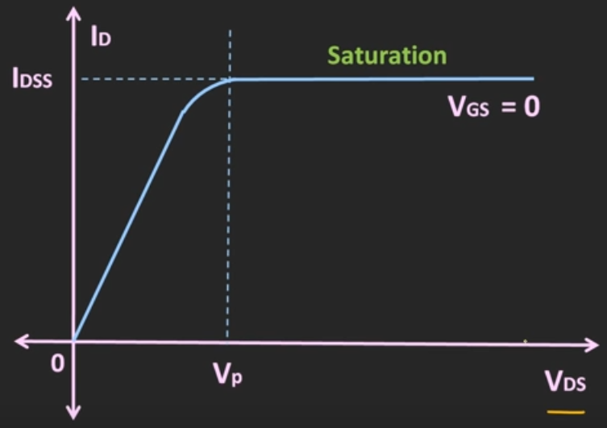
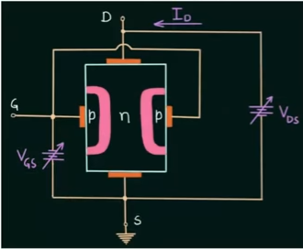
If VGS is more and more negative, reverse bias happens on P type material
The pinch off can achieve at lower value of VDS

Slide 5
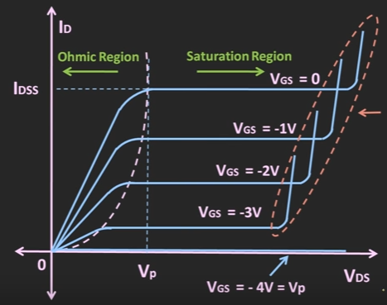
Ohmic region
The VDS and ID are linearly related
Saturation region
After pinch off, the ID reaches to a saturation level,. This value decreases as the VGS become more and more negative
Cut off region
When VGS=-VP, then the ID=0 and the device will off completely

Slide 6
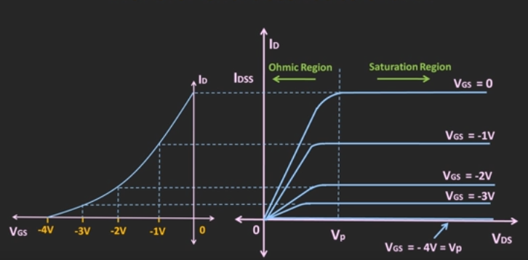
Transfer characteristics

Slide 7
Transfer characteristics
Draw a horizontal line from the output characteristics to the transfer characteristics graph and mark ID in it
Draw a vertical line from the VGS value and join on corresponding ID
Then we will get transfer characteristics plot
A non linear graph

Slide 8
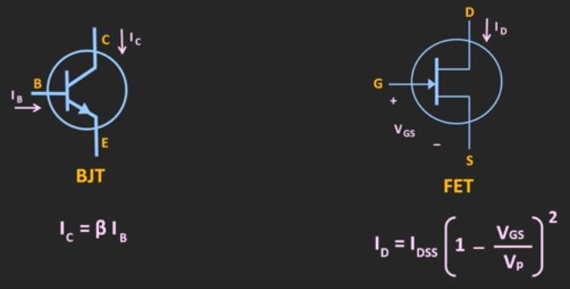
Comparison of output current of BJT and JFET
When VGS=0, ID=IDSS
When VGS=VP, ID=0

Slide 9
Thank You

